Slide 1
Thursday
Presentations (Java, Python, C++)
Small groups (mixed languages) to answer questions on Moodle
General lecture to finish up Data Types implementation choices

Slide 2
Presentations
Java
Python
C++

Slide 3
Small groups
Goal: to make sure everyone understands the differences

Slide 4
For any language you use:
Is your language statically or dynamically typed?
Strongly typed or weakly typed?
Explicitly typed or implicitly typed?
Are some variables mutable while others are immutable?
Lifetime categories are related to storage location. Which, would you deduce, is your (inclass) language? Your PLP language?
Static | Explicit Heap-dynamic
Stack-dynamic | Implicit Heap-dynamic

Slide 5
Next presentation (for Tues) For your in-class language:
What are the type-conversions supplied by the language? (including as operations are implemented)?
How (where) are these types implemented?
What is the impact of this implementation?

Slide 6
Data Types
Primitives: int, float, boolean, char (some languages)
Data structures (built-in):
string, array/list/tuple, dictionary or hash (associative array), sets
Data structure classes: stack, queue, trees, etc.
Custom classes: (e.g. a Person class with name, id, etc)

Slide 7
Data Types
Primitives vs Objects
Values stored on the stack vs References stored on the stack
Mutable vs Immutable

Slide 8
Data Types
Data values stored on the stack or on the heap?
A little murkier than just this question since there needs to be some connection to the stack.
Stack Data stored
as value on the stack
as a reference (to a value on the heap)

Slide 9
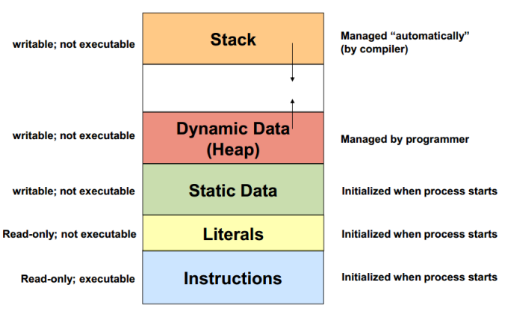
Data Type location: Stack vs heap
Notes:
https://stackoverflow.com/questions/32418750/stack-and-heap-locations-in-ram

Slide 10
Data Types: Java Object Oriented Programming
Classes: abstract data type.
Static methods and attributes are loaded in memory at load time (before the program runs).
Other methods are compiled into assembly and stored in the code segment for each object to use collectively.
Objects: instantiated using the Class blueprint: allocated space in memory for attributes.
Data structure classes: stack, queue, trees, etc.
Custom classes: (e.g. a Person class with name, id, etc)
Notes:
Which of these things will not have a predicable size? Or will possibly be big?

Slide 11
Data Types: closer look at Objects, Python
Class definition and resulting Objects
Objects have attributes (data values) and methods, outlined by the class that defines the object.
Python:
All items in Python are references to objects, including primitives
However, for primitives (and strings, tuples), the stored values are immutable so aliasing is not at issue.
x = -5
print(type(x))
print(dir(x))
Notes:
(see datatypes.py)

Slide 12
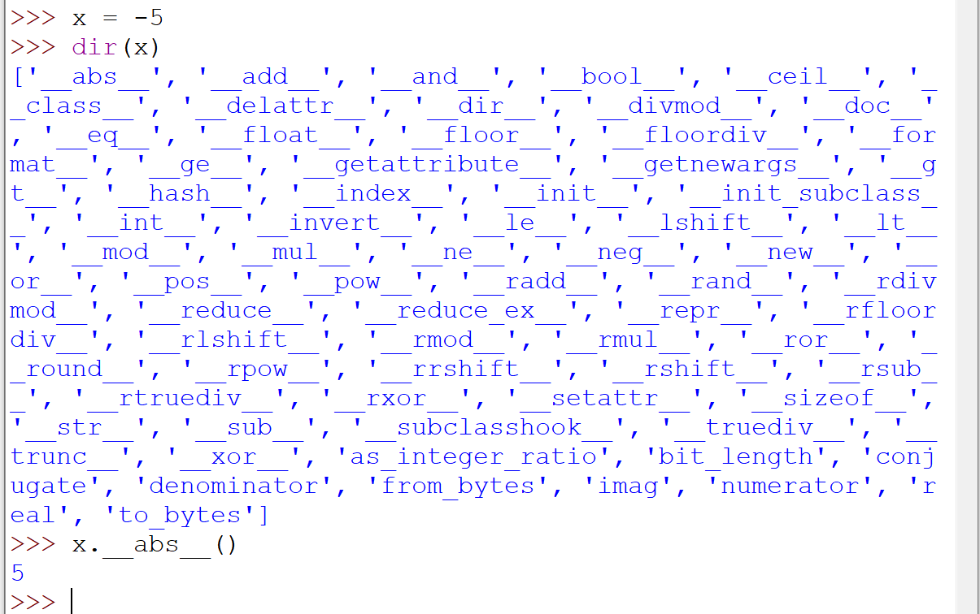

Slide 13
Data Types Declaration
Declare variable before use
Python: variable must be initialized with a value (and that sets its type)
Value stored on heap (if not already cached there)
The value is bound to a name stored on the stack.
Java: variable must be formerly declared
Typed and named, initial value (or default)
Memory set aside on stack (primitives) or heap (objects) with ref on stack
(BTW) C: all variables declared at the top of the function

Slide 14
Data Types: Java vs Python
Technically, variables are named storage slots (Java)
Java: To change the value, write a different value in the storage slot. For primitives, storage slots on the stack.
For Objects (Strings, ArrayLists<>, etc.) , reference (to a heap storage slot) is stored on the stack.
“Reference”/ “address”/ “pointer” are used somewhat interchangeably.
Python:
Technically, python doesn’t have variables just names bound to references.
A reference is the (address on the heap) of a value/ object.
To change the referred-to value, bind the name to a different value on the heap.
The properties of the referred-to object are bound to the object.
There are no bare primitive values (even int, float, etc have a full set of methods like objects)

Slide 15
Python
x = 1 x = x + 1 nums = [1, 2, 3] nums.append(4)
Notice that informal English descriptions are ambiguous.
We might say that
“x = x+1” changes x
“nums.append(4)” changes nums,
but they are very different kinds of change.
The first makes x refer to a new value (rebinding),
the second is modifying the value nums refers to (mutating the list so that it’s a longer list).
#What about?
nums2 = nums
nums2[0] = 5
Notes:
https://nedbatchelder.com/text/names.html

Slide 16
Java
int x = 1; x = x + 1; int [ ] nums = {1, 2, 3}; nums.append(4)
You will find the same (as Python) behavior for the primitives!
But with different implementation!
“x = x+1” does change the value stored at the location assigned to x (rather than rebinding)
Array size can’t be modified in java but individual the values can be (like x above)
#What about
int [] nums2 = nums;
nums2[0] = 5;
Notes:
https://nedbatchelder.com/text/names.html

Slide 17
Data Type location: Stack vs heap
Notes:
https://stackoverflow.com/questions/32418750/stack-and-heap-locations-in-ram

Slide 18
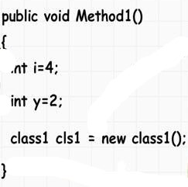
Java: Use of STACK and HEAP
Notes:
https://www.codeproject.com/Articles/76153/Six-Important-NET-Concepts-Stack-Heap-Value-Types

Slide 19
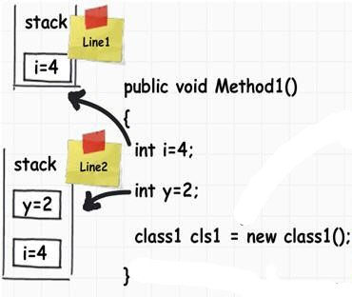
Notes:
https://www.codeproject.com/Articles/76153/Six-Important-NET-Concepts-Stack-Heap-Value-Types

Slide 20
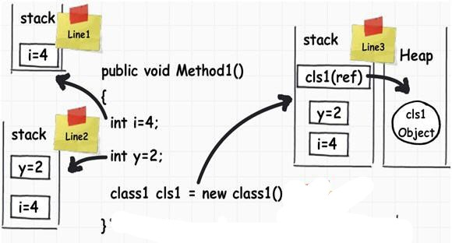
Notes:
https://www.codeproject.com/Articles/76153/Six-Important-NET-Concepts-Stack-Heap-Value-Types

Slide 21
Data Type location: Stack vs heap
Stack:
Stored in computer RAM just like the heap.
Variables created on the stack will go out of scope and are automatically deallocated.
Much faster to allocate in comparison to variables on the heap.
Implemented with an actual stack data structure.
Stores local data, return addresses, used for parameter passing.
Problem: stack overflow when too much of the stack is used (mostly from infinite or too deep recursion, very large allocations).
Data created on the stack can be used without pointers.
You would use the stack if you know exactly how much data you need to allocate before compile time and it is not too big.
Usually has a maximum size already determined when your program starts.
Heap:
Stored in computer RAM just like the stack.
Slower to allocate compared to variables on stack.
Used on demand to allocate a block of data for use by the program.
Problem: fragmentation when there are a lot of allocations and deallocations.
Problem: allocation failures if too big of a buffer is requested to be allocated.
You would use the heap if you don't know exactly how much data you will need at run time or if you need to allocate a lot of data.
Responsible for memory leaks.
In C++/C, data created on the heap will be pointed to by pointers and allocated with new or malloc . Variables on the heap must be destroyed manually and never fall out of scope. The data is freed with delete, delete[], or free.
Notes:
https://stackoverflow.com/questions/79923/what-and-where-are-the-stack-and-heap

Slide 22
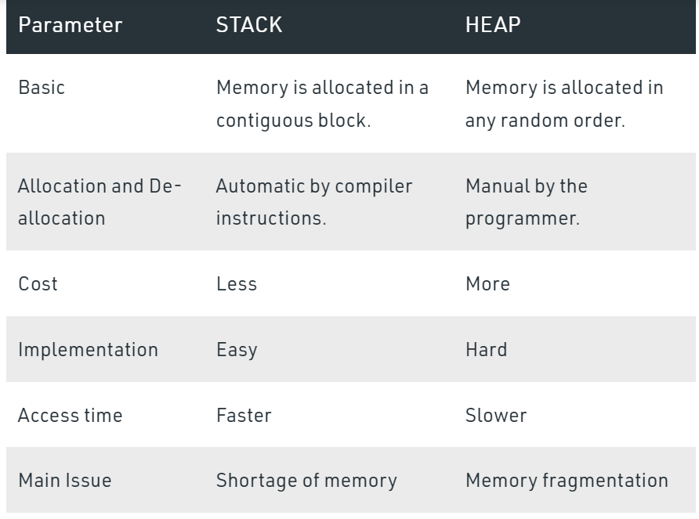
Data Type location
Notes:
Demo Java or C++ stack in jgrasp

Slide 23
Recursion example of stack overflow

Slide 24
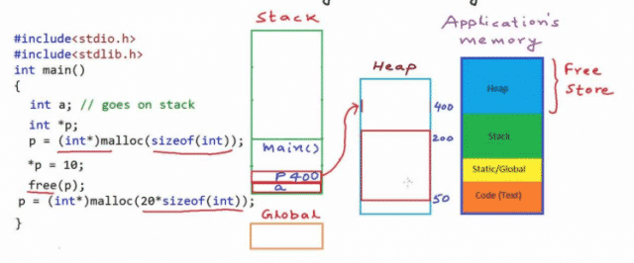
C/C++

Slide 25
Jgrasp stack demo PersonBuilder

Slide 26
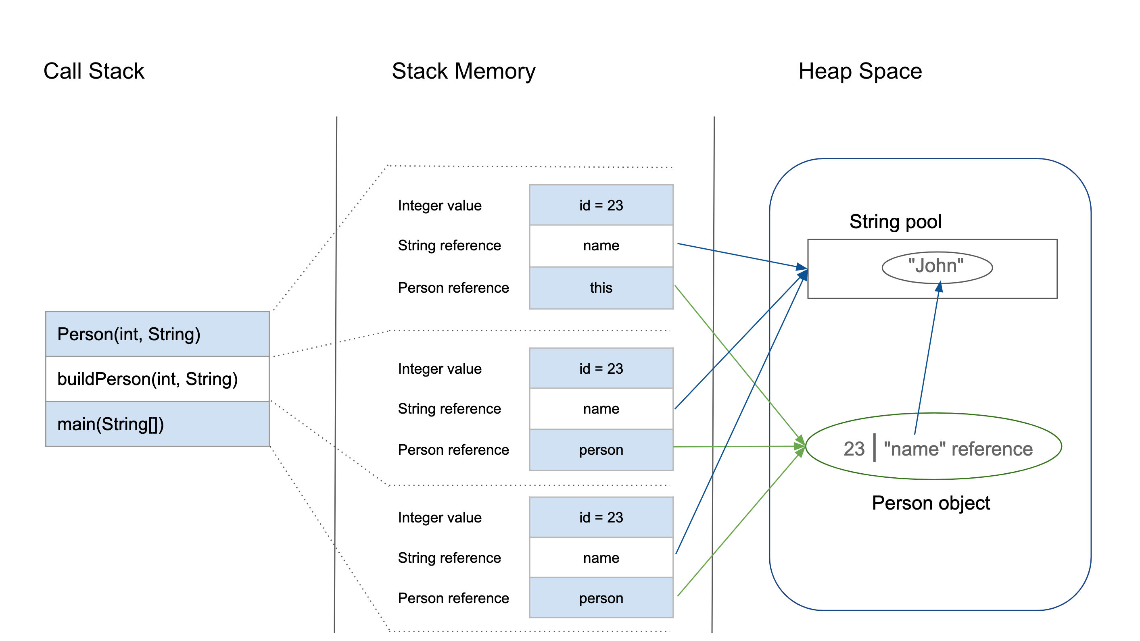
class Person { int id; String name; public Person(int id, String name) { this.id = id; this.name = name; } } public class PersonBuilder { private static Person buildPerson(int id, String name){ return new Person(id, name); } public static void main(String[] args) { int id = 23; String name = "John"; Person person = null; person = buildPerson(id, name); } }
Notes:
https://www.baeldung.com/java-stack-heap
Show in jGrasp

Slide 27
Variable values stored on the stack
Variable values stored on the Heap
Functions pushed down on the stack
Notes:
https://www.baeldung.com/java-stack-heap

Slide 28
Variable values stored on the stack
Variable values stored on the Heap
All open functions
Referred-to values
Functions pushed down on the stack
Primitives and references
Notes:
https://www.baeldung.com/java-stack-heap

Slide 29
Java arrays vs Python lists
What, exactly, is an array?
An array type describes a contiguously allocated nonempty set of objects with a particular member object type, called the element type.
array_loc + index * element_size
Notes:
https://nedbatchelder.com/text/names.html

Slide 30
Java arrays vs Python lists
Java arrays are contiguous in memory and store the values in these adjacent cells.
All the cells have to be the same size and shape: that is the same type.
Python lists hold references to values in each cell (which, as addresses, are the same size).
However, the references do not have to be to objects of the same type and therefore not (necessarily) the same size.
int[] xAry = {1,"hello"};
TestingTypes.java:10: error: incompatible types: String cannot be converted to int
Notes:
https://nedbatchelder.com/text/names.html

Slide 31
C++ Data Types
Java vs C++
C++ allows the explicit creation of references (variables that have addresses as values, also called pointers)
Lab 4 will look at these particular C++ variables.

